Slide 1


How your Property is Assessed, the Appeals Process, and NEZS
Office of the Assessor

Slide 2
Your taxes will not increase because the Assessed Value of your home increased.
It’s import to note that while Detroit is experiencing a renaissance in property values, property taxes in Michigan are not based on the market value of your property as long you own your property. Under the Michigan constitution, Article IX, Chapter III, your property taxes may only increase by the consumer price index (CPI) or five percent (5%), whichever is lower, as long as you own your home. The Assessed Value and State Equalized Value (SEV) of your home represents what the assessors believes is fifty percent (50%) of the market value of your property. Taxable value, which is what your property taxes are based upon, is a completely different calculation. To say it another way, the assessed value of homes in Detroit increased by 23% this year. But your property tax bill will only increase by 5% this year.

Slide 3
As we talk about Property Taxes, there are several terms to remember.
Assessed Value – it represents what the local assessor believes is fifty percent (50%) of the market value of your home as of December 31st of the previous year. This value is tied directly to market value and will raise or fall based on market condition.
State Equalized Value (SEV) – this is the value after both county and state equalization has taken place, and like Assessed Value, represents fifty percent of the market value of the property. Just like the city has to value at fifty percent of market value, so does the county and state. This is the process to ensure that all properties within the county are at fifty percent (50%) of market value as well as the state of Michigan.
Taxable Value is the calculation that your property taxes are based upon. It will only increase by the rate of inflation or five percent (5%) whichever is lower, as long as you own your home. It is based on the Capped Value Formula which is as follows:
2024 Capped Value = (2023 Taxable Value – losses) x the lower of the CPI or 5% + Additions

Slide 4
As we talk about Property Taxes, there are several terms to remember.
Capping – it means that the taxable value of your property will not increase more than the CPI or 5% (whichever is lower) as long as you own your home.
Uncapping – the taxable value of a property will uncap (meaning the Assessed and Taxable Value are the same) the year after you sale your property. Then the taxable value will be capped as long as the new owner owns the home.

Slide 5

Detroit has a three-tier appeals process
The Assessors Review, which runs from February 1 through 22, is designed to be an informal process in which the property owner can question how the city has valued their property. If they believe the assessment is unfair, they can request a review by a staff member. Beginning with the 2024 appeals season, Detroit City Council expanded who may file an appeal during the Assessor Review to include anyone with a financial or legal interest in the property.

Slide 6

March Board of Review
The Detroit Board of Review consists of nine members appointed by Detroit City Council to hear property tax appeals. This is a more formal process than the Assessor Review. It requires to taxpayer to present evidence as to why the Assessment is incorrect. Changes by Detroit City Council beginning with the 2024 tax year no longer require a residential property owner to begin their appeal at the Assessor Review, you may now proceed directly to the March Board of Review. Keep in mind, Michigan law governs the March Board of Review and limits who may appeal to the property owner or their agent.

Slide 7

Michigan Tax Tribunal
The third and final step in the property appeals process is the Michigan Tax Tribunal (MTT). The MTT is a state administrative court with final jurisdiction over valuation appeals.
You must file an appeal with the March Board of Review before proceeding to the MTT.
The deadline to appeal a decision of the March Board of Review is July 31
Commercial, Industrial, and Personal Property Owners may proceed directly to the MTT without filing with the MBOR. Their deadline to file an appeal with the MTT is May 31

Slide 8
Neighborhood Enterprise Zones - Homestead
Office of the Assessor

Slide 9
What is a NEZ Homestead?
Neighborhood Enterprise Zone Homestead (NEZH) is a property tax abatement program for Residential Property Owners who both own and occupy their home as their principal residence.
What are the requirements for the program?
Your property must be in one of the 152 NEZ Homestead Districts throughout the City of Detroit
You must have purchased the property after 12/31/1996
You must both own and occupy the property as your principal residence
You must stay current on your property taxes
You must commit to a minimum of $500 of improvements or repairs to your property over the course of the first 3 years
You must have filed a Property Transfer Affidavit (PTA) and Principal Residence Exemption (PRE) with the City of Detroit, Office of the Assessor

Slide 10
What is a Neighborhood Enterprise Zone - Homestead (NEZH) abatement and how does it affect my property?
The NEZH is an abatement for an existing structure (house), purchased by or transferred to an owner after December 31, 1996, which is the primary residence of the owner, is located within a zone created by the legislative body of a local government unit (in this case, Detroit City Council), and which the owner of the property commits to a minimum of $500 in repairs or improvements over the first three-year period of the abatement.
The Neighborhood Enterprise Zone Act, PA 147 of 1992, as amended, provides tax exemptions for the development and rehabilitation of residential housing located within eligible distressed communities. The legislative body (Detroit City Council) of the local governmental unit (LGU) in these eligible distressed areas can designate areas as NEZs. Only homes located within these established NEZs are eligible for NEZ certificates. Once a NEZH zone is created by Detroit City Council, NEZ Homestead applications are filed, reviewed and approved by the local assessor.
This abatement last for 15 years and is transferrable, meaning if the owner sells the property, the new owner can take advantage of the abatement as long as they meet the qualifications.

Slide 11
The Neighborhood Enterprise Zone Act, PA 147 of 1992, as amended, provides tax exemptions for the owner/occupants of residential housing located within eligible distressed communities. The governing body (Detroit City Council) of the local governmental unit (LGU) in these eligible distressed areas can designate areas as NEZHs. Only homes located within these established NEZs are eligible for NEZ certificates.
What is the difference between a Neighborhood Enterprise Zone “New and Rehab” and a Neighborhood Enterprise “Homestead” Zone? A Neighborhood Enterprise Zone (NEZ) covers new facilities and/or rehabilitated facility projects. A Neighborhood Enterprise “Homestead” Zone covers only pre-existing residential property, located within a subdivision platted pursuant to state law before January 1, 1968.
Who can apply for a Neighborhood Enterprise Zone (NEZ) Homestead Certificate? Only the owner/occupant of a principal residence within an NEZH zone may file an application for the tax abatement
How is the NEZH Tax Computed? A parcel holding a NEZH Certificate will receive two tax bills, one for the land and one for the house. The abatement is applied only to the house, while the land is taxed at the regular tax rate. The NEZH does not prevent the property owner from exercising their rights to seek a reduction of their property value during the City of Detroit’s Assessor Review. In addition, both the land assessment on the ad valorem roll and the improvement (house) on the special act roll may be adjusted by the March Board of Review.

Slide 12
How much is the tax reduction ?
It is approximately a 15 to 20 percent reduction in your Summer Tax Bill
The NEZ tax abatement reduces the City of Detroit Operating Millage from 19.9520 to 9.9760 mills and the Wayne County Operating Millage from 5.6483 to 2.8241 mills. All other millage rates are unaffected by the NEZ Homestead abatement
How long does the abatement last ?
The abatement certificate is issued for 15 years and will last as long as you own your home
How do I apply for the program ?
You may apply online at: http://detroitmi.gov/departments/office-chief-financial-officer/ocfo-divisions/office-assessor/nez-homestead. You may also download, print, and mail the application from the following website: http://www.Michigan.gov/documents/taxes/2704BNNEZHomestead_181899_7.pdf
Is there a deadline to file ?
The Office the Assessor accepts applications all year. The abatement to be effective for the year you first qualify
Any application submitted after September 1 will be processed the following year
What documentation will I need
A driver’s license or state issued ID with the property address
The Principal Residence Exemption (PRE) must be on file. If not, you will need to fill out the application
If no Property Transfer Affidavit (PTA) is on file, you will be required to present a certified deed showing ownership of the property and pay the PTA fine for not filing the affidavit timely

Slide 13
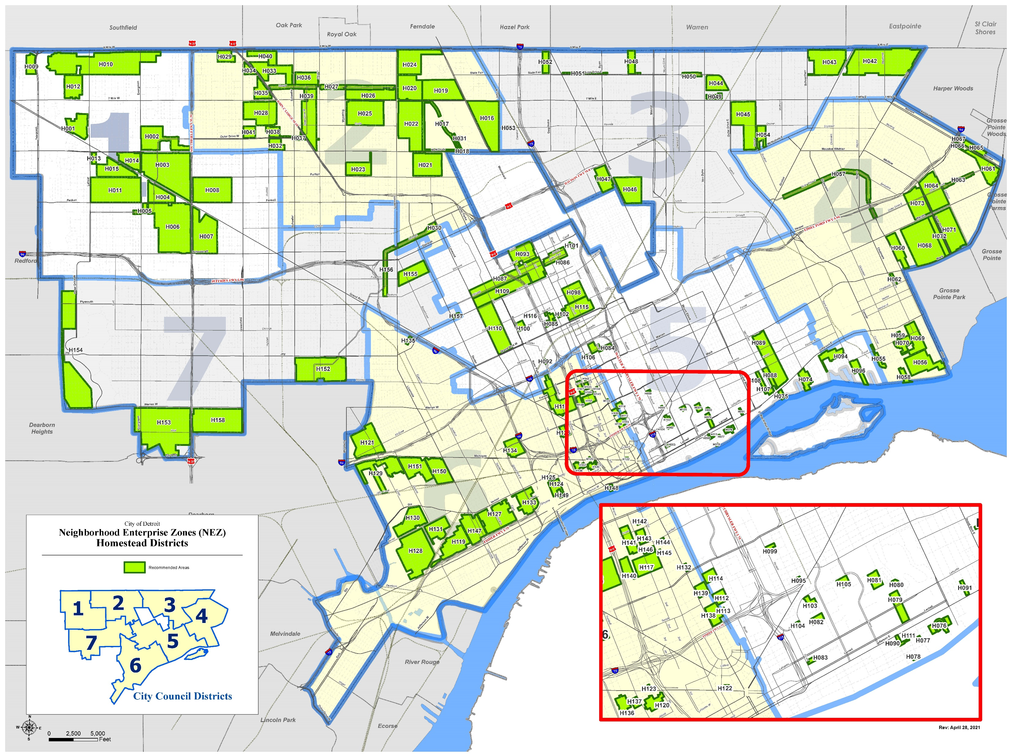

Slide 14
Homeowners Property Exemption (HOPE)

Slide 15
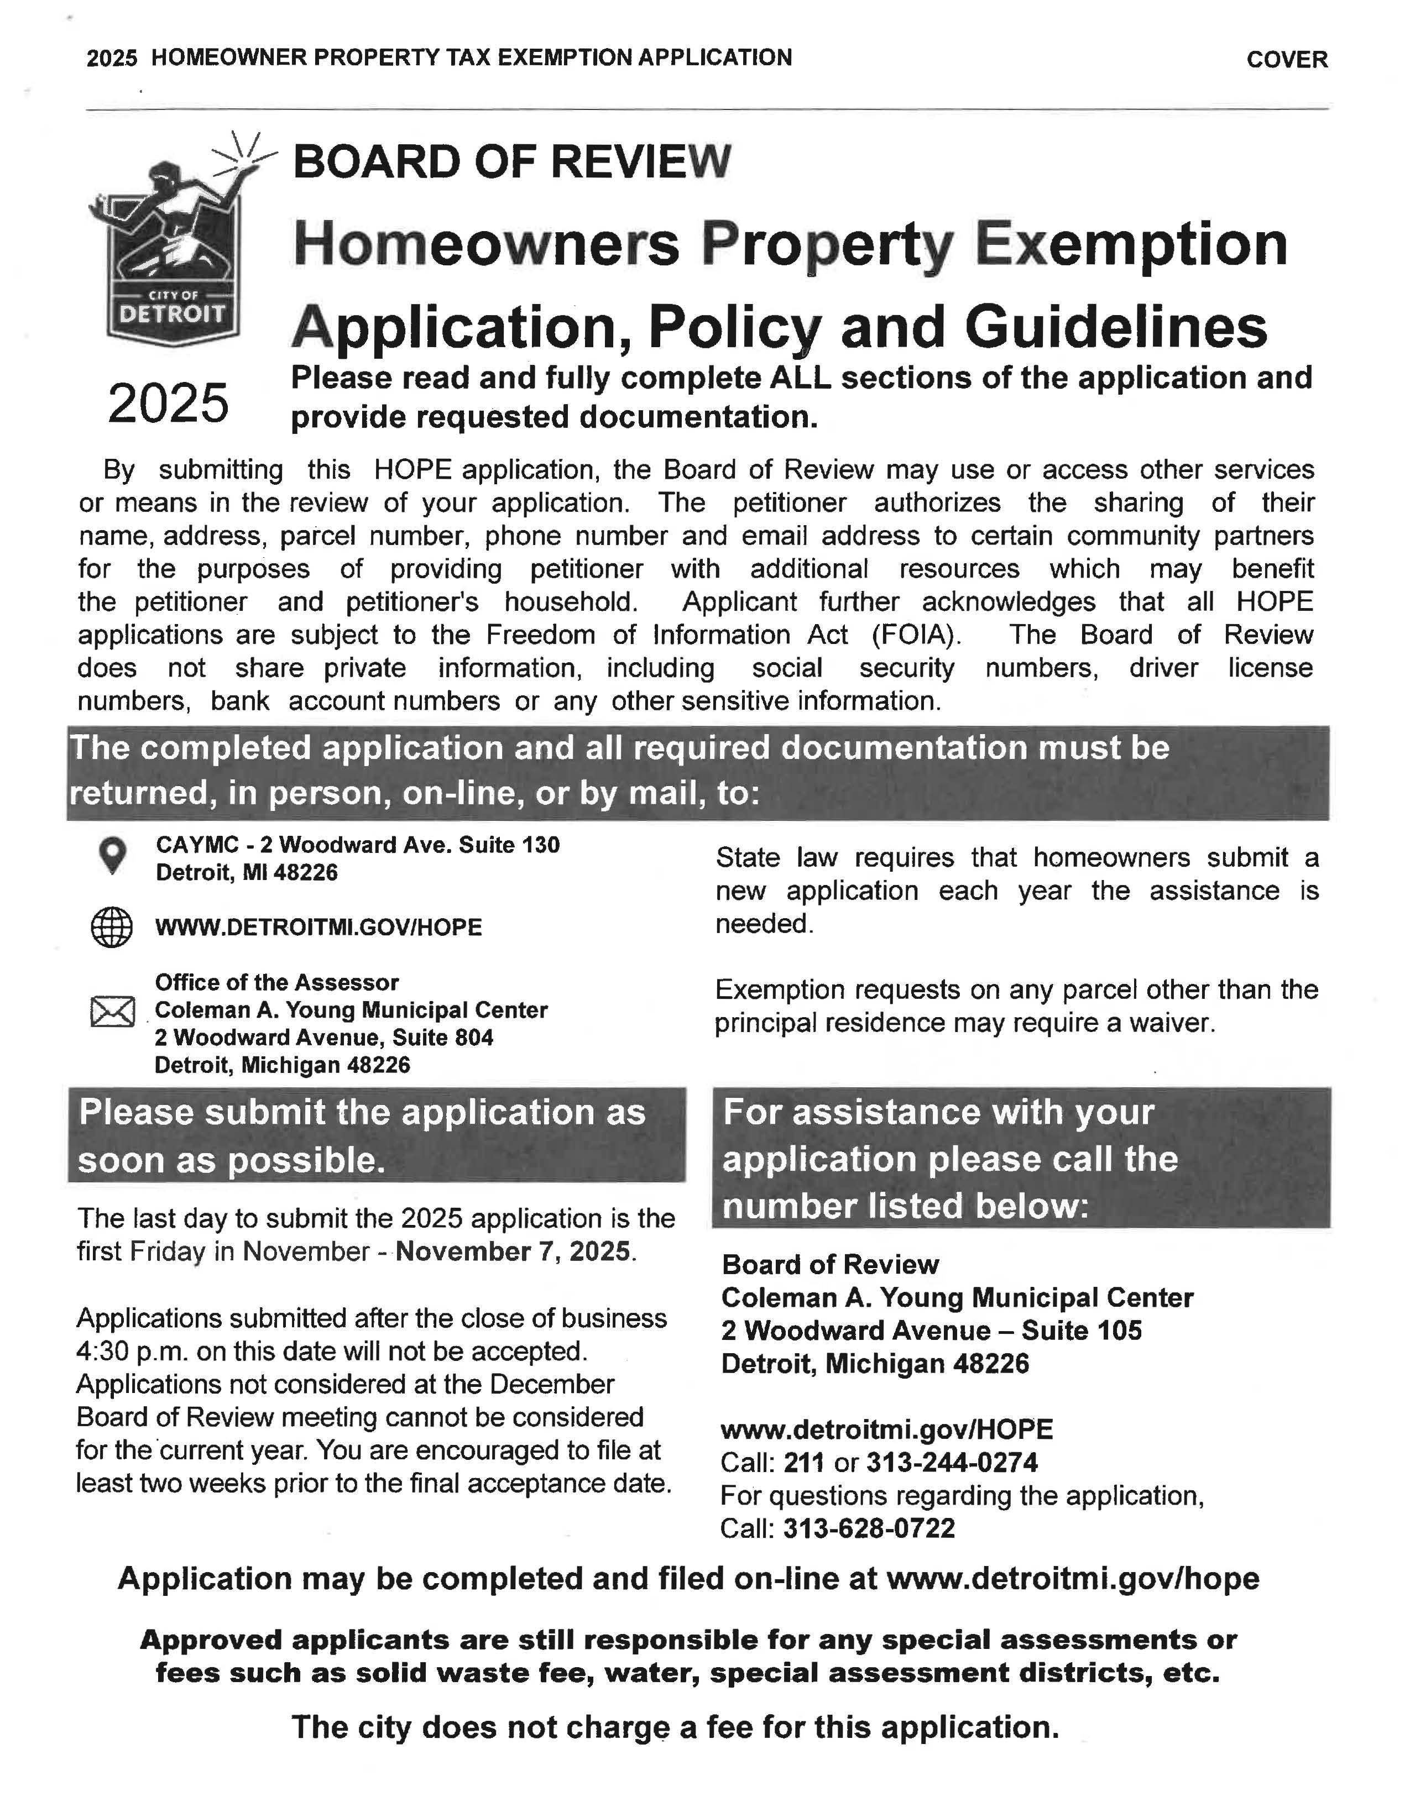

What is a HOPE (formerly HPTAP)?
HOPE stands for Homeowners Property Exemption. It is also referred to as the Poverty Tax Exemption, “PTE” or Hardship Program. HOPE provides an opportunity for homeowners to be exempt from their current year property taxes based on household income or circumstances. If approved, you will still be responsible for any fees such as the solid waste fee. The solid waste fee is discounted at to $120 for HOPE approved homeowners. The HOPE application is an annual application, homeowners must apply every year.
Do I qualify?
Eligibility for the HOPE is based on whether you own and occupy your home as your primary residence and your household income or circumstances. Please review the income levels listed below. Most homeowners whose income is below the guidelines are generally approved.
Only the Board of Review may approve an application.

Slide 16
How TO APPLY:
ONLINE
MAIL
IN-PERSON

Slide 17
How you can apply
On-Line:
Online Appeals may be submitted at www.detroitmi.gov/HOPE
In-Person Visit:
Coleman A. Young Municipal Center,
2 Woodward Avenue, Suite 130
Detroit, Michigan 48226
Mail:
Atten: Board of Review
Coleman A. Young Municipal Center,
2 Woodward Avenue, Suite 804
Detroit, Michigan 48226

Slide 18
Decisions are rendered three times a year:
March Board of Review - Tuesday following the 1st Monday in March
July Board of Review - Tuesday following the 3rd Monday in July
December Board of Review - Tuesday following the 2nd Monday in December
Taxpayers are notified of their decision via USPS Mail

Slide 19
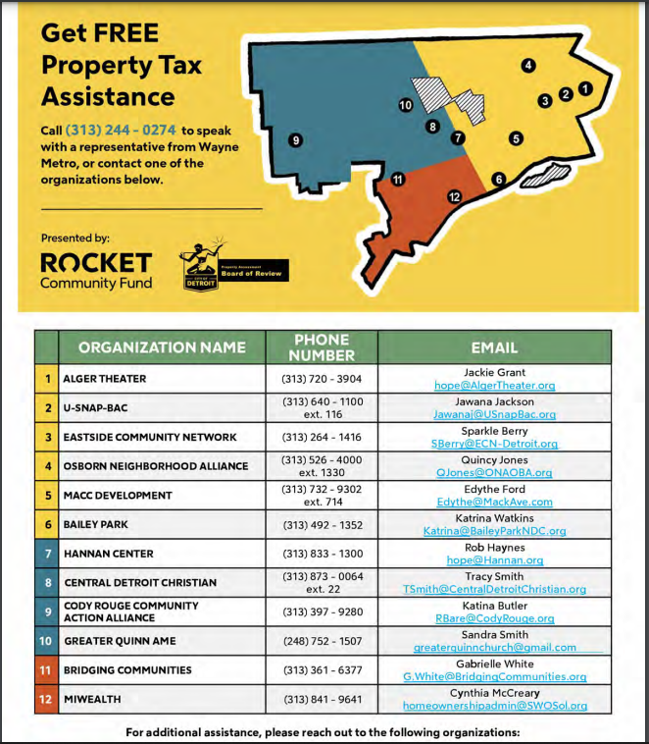
Need Assistance Applying?

Slide 20
Changes in Law
Changes to state law allow the assessor to extend the HOPE exemption to those property owners whose sole source of income is from:
Social Security
Supplemental Social Security
Social Security Disability Insurance (SSDIB)
The Assessor is required to perform periodical audits to ensure that anyone who receives the extension qualifies.

Slide 21

Changes in State Law
Changes to state law allow the assessor to grant disabled veterans an exemption for property taxes. It also allows the assessor to extend the exemption without the need for a yearly application.
The assessor is required to audit this program to ensure that anyone granted the disable veterans exemption actually qualified for the exemption.

Slide 22
Remember the deadline for 2025 is November 7, 2025

Slide 23
Bagley NEZ Homestead Expansion
Will be retroactive to cover 2024 tax year
No objections from City Law Department (Corporation Counsel)
No objections from Office of the Chief Financial Officer (CFO)
No objections from Legislative Policy Division (LPD)
Public Hearings will be held before Detroit City Council
Approved by resolution (Only Detroit City Council can create or modify an NEZ)
Property Owners will receive refunds on previous tax bills.

Slide 24
Board of Assessors – Office of the Assessor
Alvin Horhn – Deputy CFO/Assessor horhna@detroitmi.gov
Charles Ericson – Assessor ericsonc@detroitmi.gov
Cynthia Burton – Deputy Assessor burtoncyn@detroitmi.gov

